Slide 1


Phishing Awareness Campaign
This campaign aims to educate employees about the dangers of phishing attacks and how to recognize them. By raising awareness, we can protect sensitive information and enhance our organization's cybersecurity posture. The campaign will include various educational materials and interactive elements to engage staff effectively.

Slide 2

CONTENTS(1)
Campaign Objectives
Target Audience
Key Messages
Educational Content

Slide 3

CONTENTS(2)
Interactive Elements
Distribution Channels
Evaluation and Feedback
Conclusion

Slide 4


Campaign Objectives
1
Raise Awareness
Educate employees about phishing threats.
2
Enhance Security
Promote best practices for email security.
3
Encourage Reporting
Motivate staff to report suspicious emails.

Slide 5

Campaign Objectives
Educate the public
Provide practical tips
Educate the public about phishing threats.
Provide practical tips for identifying phishing attempts.
Encourage safe practices
Foster cybersecurity culture
Encourage safe online practices.
Foster a culture of cybersecurity awareness.

Slide 6


Target Audience
Employees
Organizational Staff
Management
All staff members across departments.
Leaders responsible for decision-making.
Individuals involved in daily operations.

Slide 7
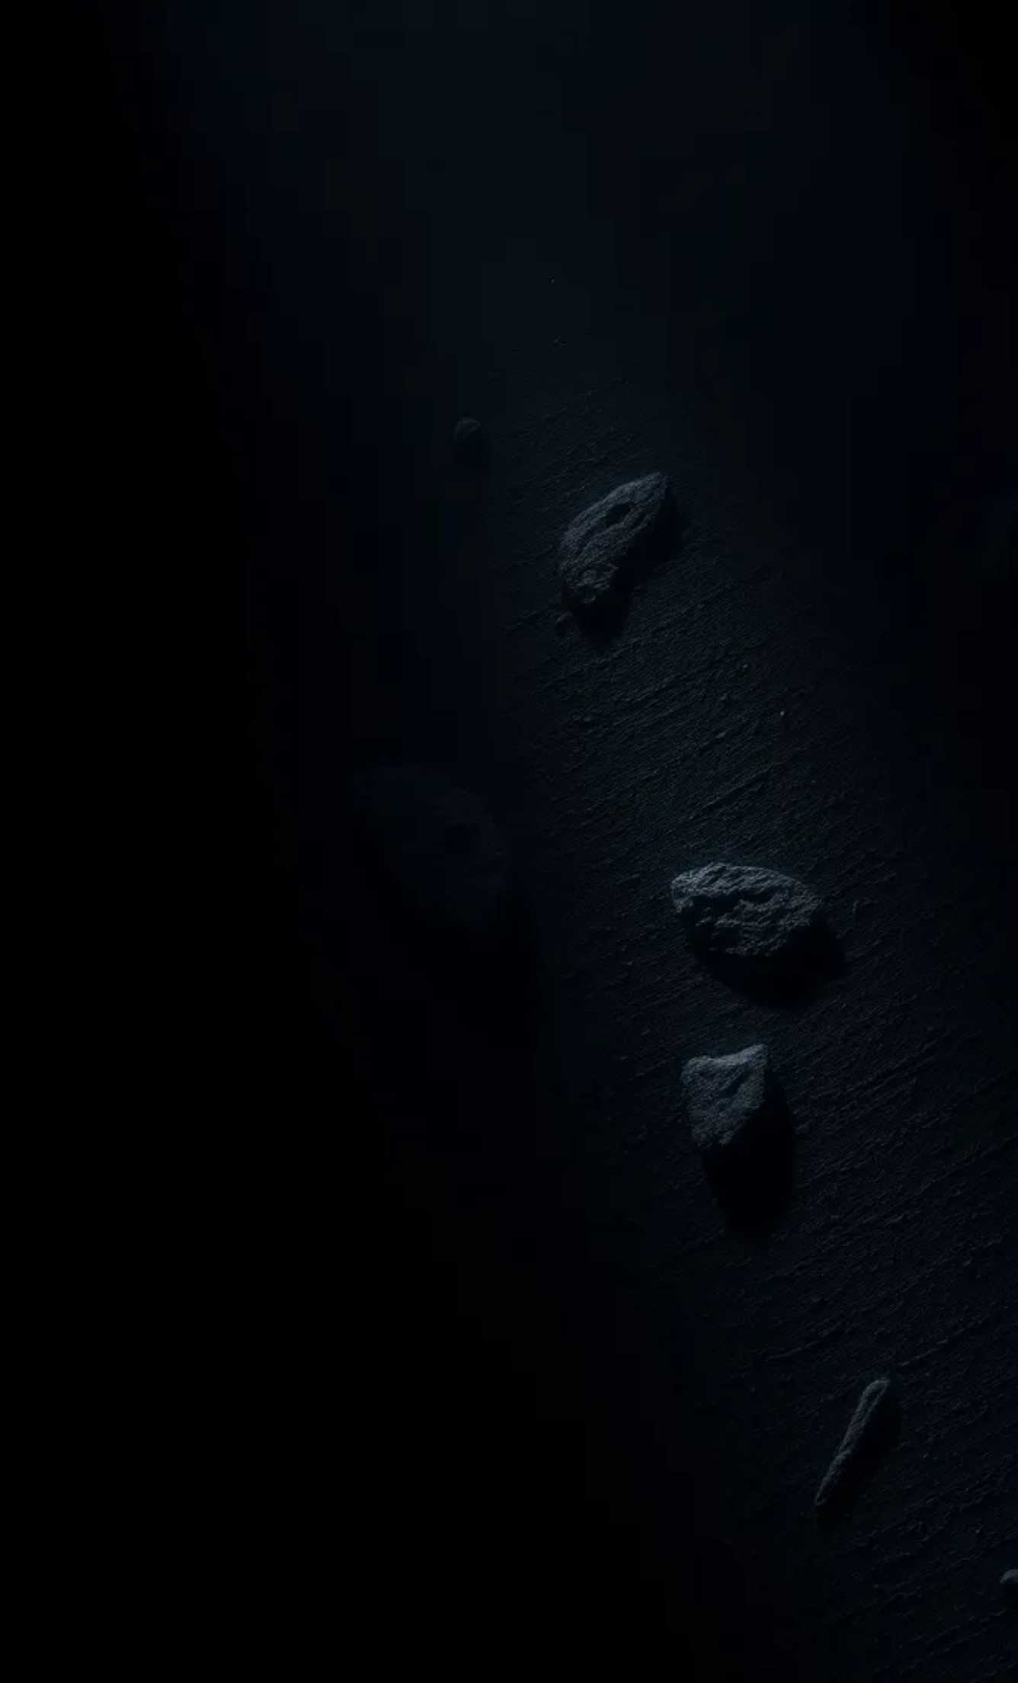
Target Audience
General Public
Organizational Employees
General public (internet users).
Employees of organizations.
Students and Educators
Vulnerable Populations
Students and educators.
Vulnerable populations (e.g., elderly individuals).

Slide 8


Key Messages
Stay Informed
Verify Sources
Report Suspicious Activity
Regularly update your knowledge on phishing tactics.
Always check the authenticity of emails and links.
Immediately report any phishing attempts to IT.

Slide 9

Key Messages
Think before you click.
Verify the source.
Never share personal info.
Report suspicious activities.

Slide 10

Educational Content
Understanding Phishing
Learn the basics of phishing attacks.
Recognizing Signs
Identify common signs of phishing emails.
Preventive Measures
Implement strategies to avoid phishing.

Slide 11

Educational Content
1
Definition of phishing
2
Common tactics
Common phishing tactics (e.g., fake websites, urgent messages).
Definition of phishing and its types (e.g., spear phishing, whaling).
3
Real-life examples
4
Consequences
Real-life examples of phishing attacks.
Consequences of falling victim to phishing.

Slide 12


Interactive Elements
Quizzes
Simulations
Feedback Forms
Engaging quizzes to test knowledge on phishing.
Realistic phishing simulations for hands-on experience.
Collecting feedback to improve future training.

Slide 13


Interactive Elements
Quizzes
Scenarios
Workshops
Quizzes to test knowledge on phishing.
Scenarios for participants to identify phishing attempts.
Workshops or webinars for in-depth discussions.

Slide 14

Distribution Channels
Email Campaigns
Intranet Posts
Workshops
Conducting interactive workshops for staff.
Utilizing targeted emails to reach employees.
Sharing information on the company intranet.

Slide 15

Distribution Channels
Social Media
Email Newsletters
Social media platforms (Facebook, Twitter, LinkedIn).
Email newsletters.
Community Events
Local Collaborations
Community events and workshops.
Collaborations with local organizations and schools.

Slide 16

Evaluation and Feedback
Survey Results
Focus Groups
Performance Metrics
Collect feedback through surveys to assess campaign effectiveness.
Conduct focus groups to gather qualitative insights from participants.
Analyze key performance indicators to measure engagement and awareness.

Slide 17
Evaluation and Feedback
1
Surveys
Surveys to gather participant feedback.
2
Engagement Metrics
Tracking engagement metrics (e.g., social media shares).
3
Phishing Analysis
Analyzing reports of phishing incidents before and after the campaign.

Slide 18



Conclusion
Key Takeaways
Ongoing Training
Employee Engagement
Phishing awareness is crucial for security.
Regular updates and training sessions are essential.
Encourage employees to report suspicious activities.

Slide 19

Thank You
1
Appreciation
Thank you for your attention and participation.
2
Stay Safe
Remember to stay vigilant against phishing attacks.
3
Feedback Welcome
We value your feedback to improve our campaign.

